Slide 1
PROWLSHOP
Viral Barot
Mirnary Carbajal
Jessica Luu

Slide 2
INTRODUCTION
eCommerce website for school resources
Purchase school supplies (Books, Pillows, Tissues, etc.)
GSU Students ONLY
COPYRIGHTED Prowlshop ©

Slide 3
Front End
Split between all 3

Slide 4
Front End (Code)

Slide 5
Backend
All 3
Connecting to Database
PHP

Slide 6
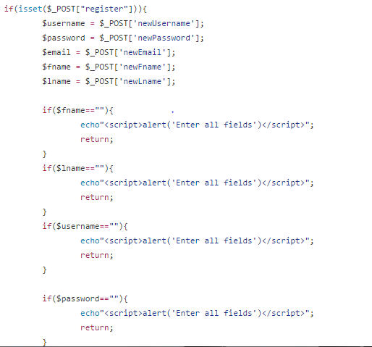
Back End (Register)

Slide 7
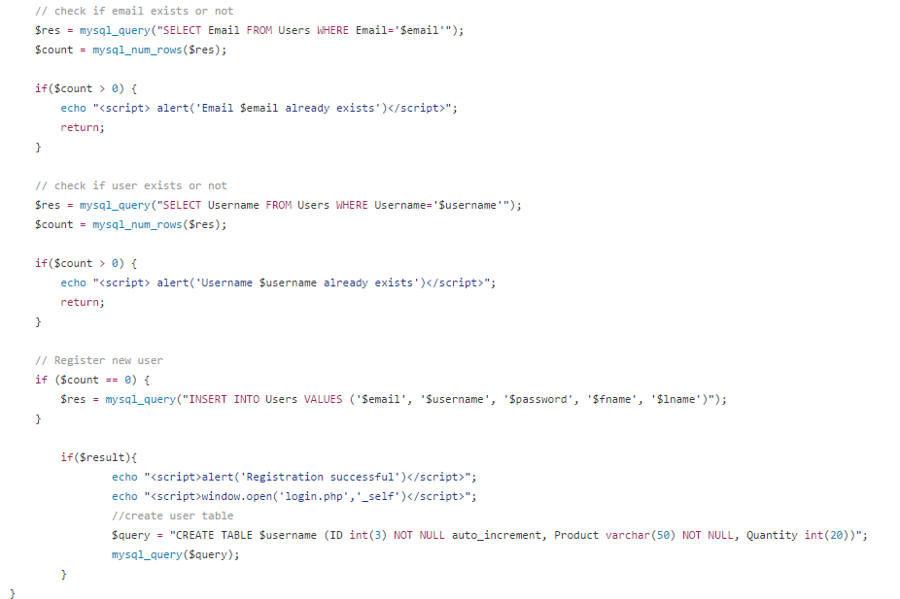
Back End (ChecK)

Slide 8
OTHER GOALS

Slide 9
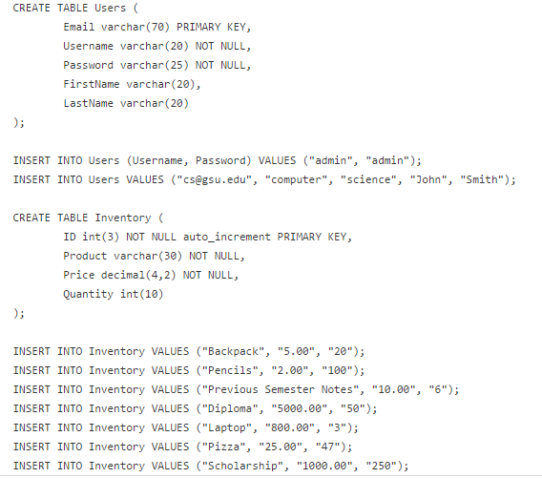
DATABASE

Slide 10
PROWLSHOP ©
ADD URL HERE

